Slide 1

Should we
keep vouchers?
By LR & HN

Slide 2
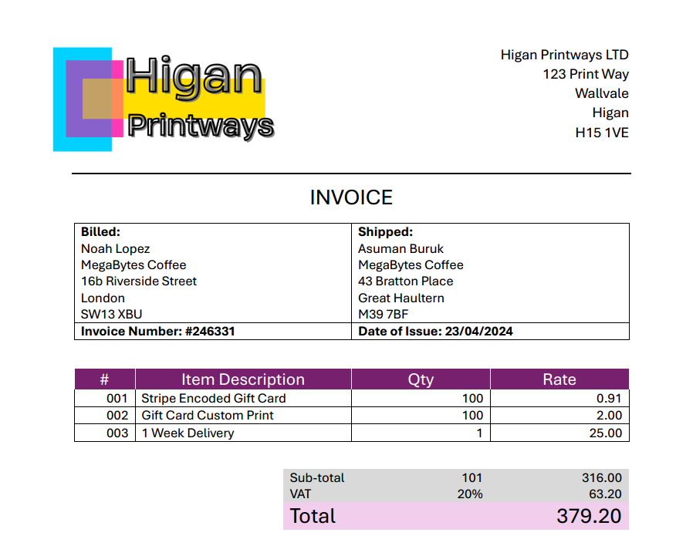
MegaBytes spends £379.20 printing physical vouchers per 100
By LR
Notes:
We saw that Megabytes purchases their gift cards from Higan Printways at £379.20 per 100 cards issued

Slide 3
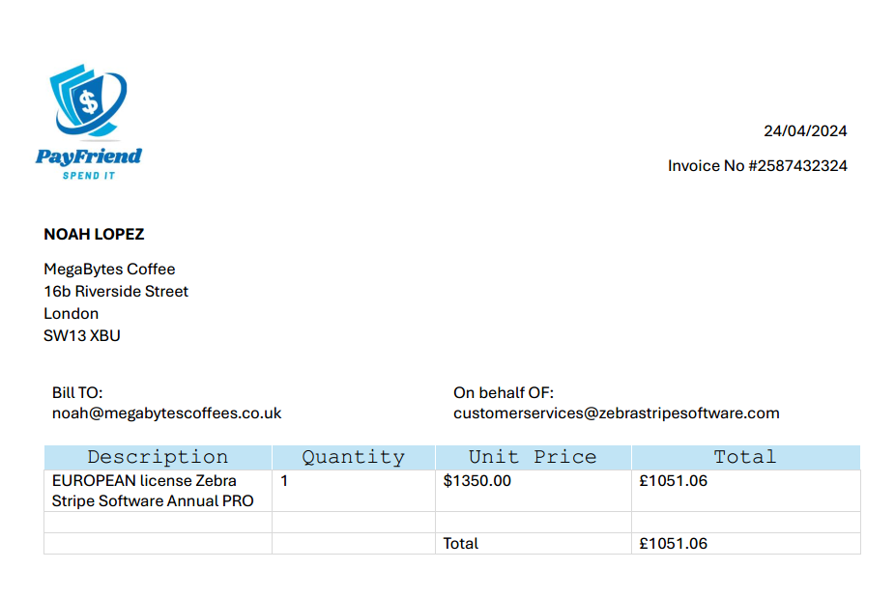
MegaBytes spends £1051.06 on voucher software per year annually
By LR
Notes:
And the next day purchased their processing software for the year for £1051.06 - which establishes an invested expense for the company that needs to be recouped

Slide 4
£20
X 8
£20
X 100
Total cost spent on gift vouchers £1430.26 by MegaBytes
£160
£2000
Average Voucher Spend by Customers
Projected Average Voucher Spend by Customers
(in one week)
By HN

Slide 5
Total cost spent on gift vouchers £1430.26
Possible return on 100
(160 / 8)*100 = 2000
160 total cost of 8 gift vouchers
1430 / 160(1 weeks voucher sales) = 9 week
In 9 weeks we can sell enough gift vouchers to cover the Total cost spent of gift vouchers and have vouchers remaining to make a profit.
By HN

Slide 6
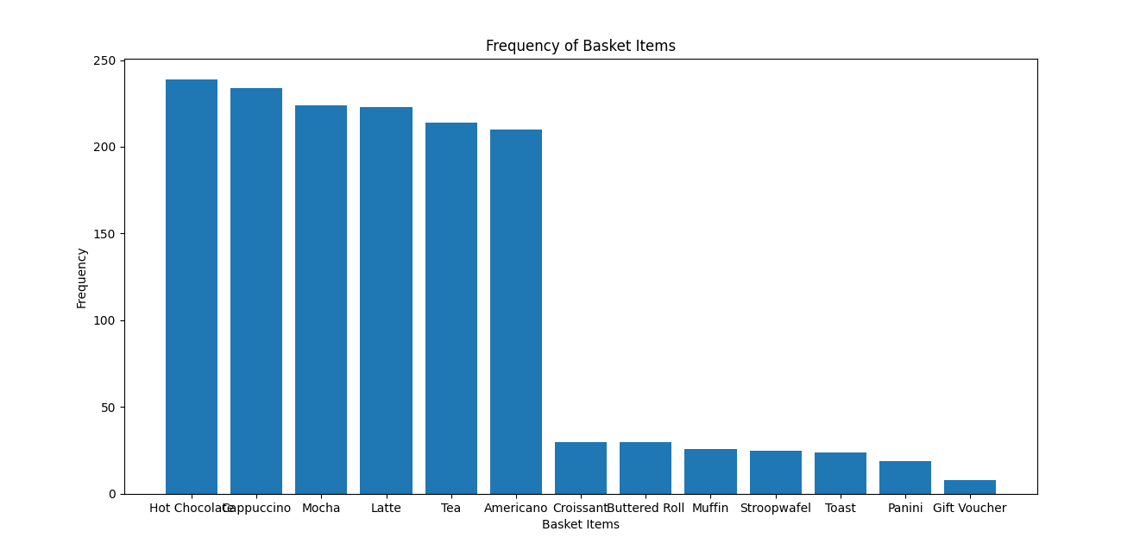
Bar chart 1
By HN
Notes:
This bar chart shows total number of sold items
After taking out duplicate values the total for gift voucher is 8 (11 with duplicates)

Slide 7
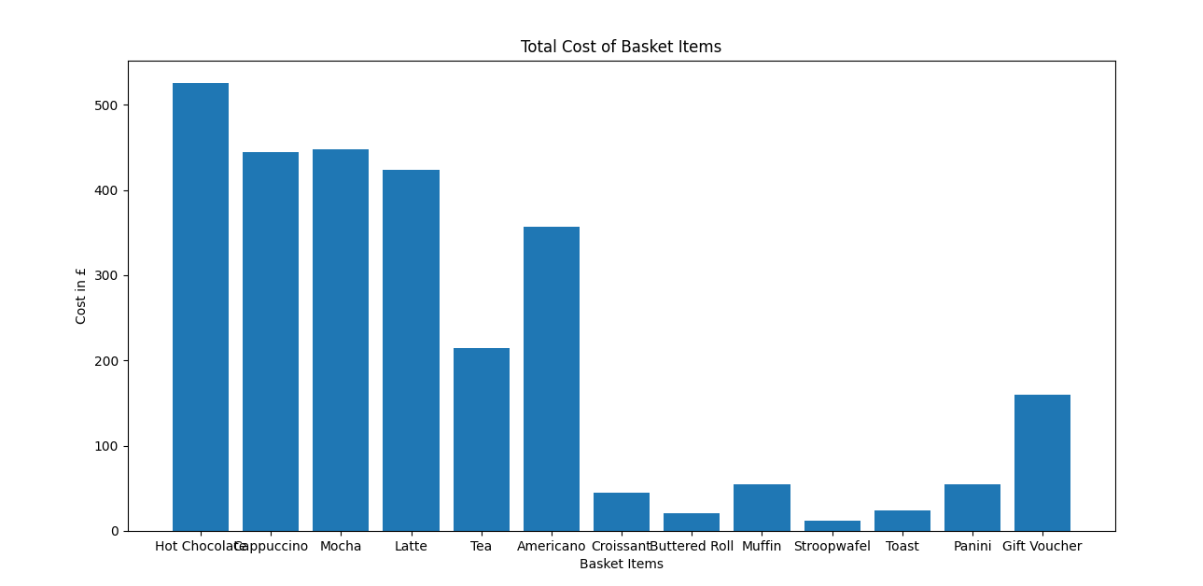
Bar chart 1.1
By HN
Notes:
This bar chart shows the total cost of each item.
Because the price of gift voucher is higher than the rest selling only 8 has made the total to £160

Slide 8
33 / 398
M T W T F S S
Total number of transactions during the week
Spent Voucher Spent Credit, Debit, Mobile Wallet, Cash
By LR
Notes:
We took the value counts of the Payment methods and from the total number of transactions 398, 33 of those were voucher transactions

Slide 9
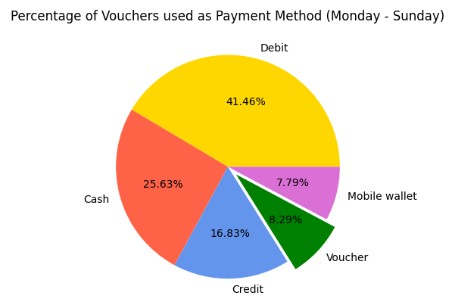
By LR
Notes:
This chart shows the percentage vouchers made up of the transaction within the week - which came out at 8.29%

Slide 10
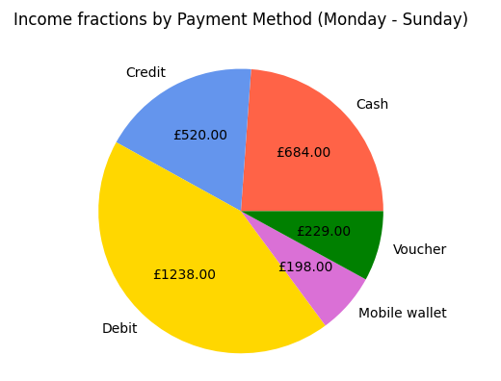
Out of a weekly income total of £2868.60
By LR
Notes:
This chart shows that as a percentage of the weeks income of £2868.60 - vouchers generated £229

Slide 11
Conclusion
8 out of 1506 (0.5%) gift vouchers of total items sold in 1 week.
160 out of 2785.3 (5.7%) in total income from gift vouchers.

Slide 12
Back to Megabytes
Utilize Accurate Data Types
Use the decimal data type for currency to avoid floating-point errors.
Standardize formats for dates, customer IDs, and product codes.
Invest in Training
Educate employees on the importance of accurate data entry and management.
Provide ongoing training on new tools and technologies for data handling.

